Slide 1
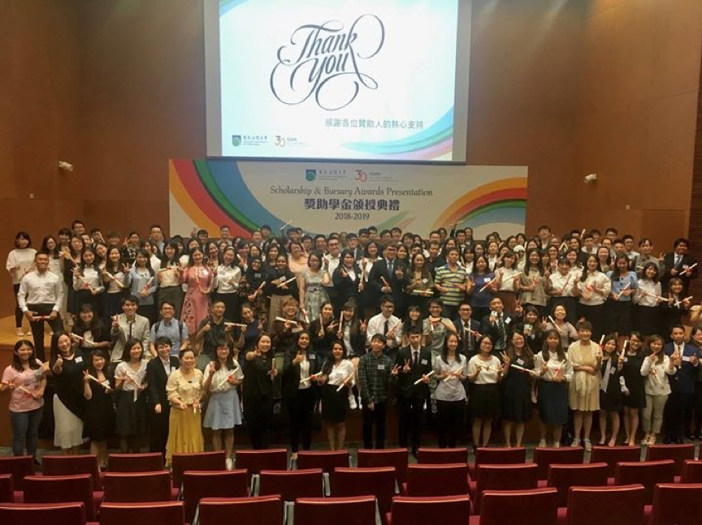
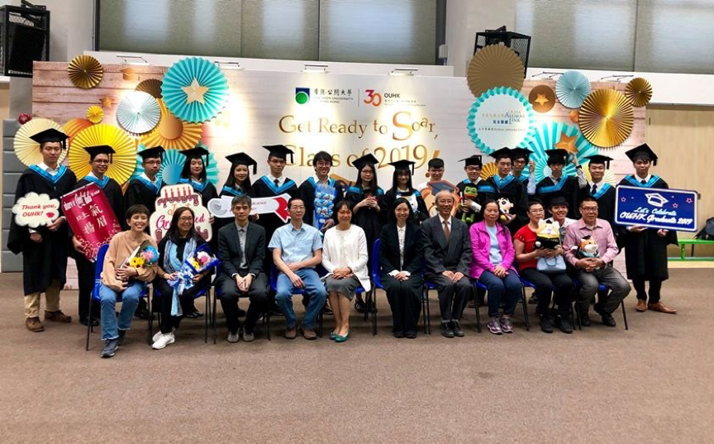
2025 Final Year Project Topics (COMP S456F, 4570SEF) Bachelor of Computing with Honours in Internet Technology Bachelor of Science with Honours in Computer Science Bachelor of Science with Honours in Computing
Prepared by Dr. Jeff Au Yeung Date: 28 July 2025

Slide 2

Hong Kong Metropolitan University
Title: | Subtitle glasses for the hearing impaired (悅聽眼鏡 v2)
Project Supervisor: | Dr. Jeff Au Yeung (email: jauyeung@hkmu.edu.hk, Tel: 3120 2606)
Description: | Smart Subtitle Glasses (SSG), designed to enhance accessibility and communication for hearing-impaired individuals. Different from existing assistive technologies, SSG integrates real-time speech-to-text transcription (STT) and multi-language translation into an augmented reality (AR) wearable device In 2024 Autumn, our FYP team developed an Android-based system which can be applied to smart glasses. We have won several awards in local and China competitions. This year, we would like to continue this project by improving the machine translation model and creating additional functions on it. Additional functions include separating the different speakers in the voice, adding sign language recognition using the built-in camera. The project is collaborating with Innospire Technology. Basic Requirement: Basic Programming Skills (Python, Mobile App programming) Basic Linux Administration. Work with your teammate closely. Apart from finish the FYP, your team is also willing to spend extra time to join various competition (This can also help to improve your CV !) The most important: You are willing to learn new things with me !!

Slide 3
Hong Kong Metropolitan University
Title: | Voice-Activated Home Security with Speech anti-spoofing on NVidia Jetson devices
Project Supervisor: | Dr. Jeff Au Yeung (email: jauyeung@hkmu.edu.hk, Tel: 3120 2606)
Description: | Voice-activated home security systems have revolutionized the way we protect and interact with our living spaces. With the power of voice commands, homeowners can now control their security devices effortlessly, ushering in a new era of convenience and innovation. In this project, we are going to build a voice-activated smart-home system using the NVidia Jetson IOT devices (https://www.nvidia.com/en-us/autonomous-machines/embedded-systems/jetson-nano/product-development/ ). Apart from the Understanding the simple commends from the user, two important features will be included. (1) Speaker Verification System which can check whether the comments is coming from an authorized person. (2) Speech Anti-Spoofing System which can discern spoofing attacks from human natural speech. Basic Requirement: Basic Programming Skills (Python, perhaps C, C++, and Mobile App programming) Basic Linux Administration. Work with your teammate closely. You will also have the opportunity to work with our research student The most important: You are willing to learn new things with me !!

Slide 4
Hong Kong Metropolitan University
Title: | Lightweight AI for Smart Review Analysis
Project Supervisor: | Dr. Kayley Xiaoxue Ma (email: kxma@hkmu.edu.hk, Tel: 3120 2717)
Description: | In today’s data-driven e-commerce landscape, customer reviews hold invaluable insights for product improvement and market positioning. However, most advanced AI analysis tools require GPU acceleration, creating barriers for small businesses and student researchers with limited computational resources. This project addresses this gap by developing a lightweight yet powerful NLP system capable of extracting meaningful patterns from reviews using only CPU-based processing, making sophisticated sentiment and trend analysis accessible to everyone. This project will design and implement a resource-efficient AI pipeline for review analysis, leveraging optimized techniques like model distillation, hybrid rule-based/ML approaches, and intelligent text preprocessing. The system will identify feature-specific sentiments, detect emerging trends through temporal analysis, and generate actionable reports with competitor benchmarking. Key components include a data processing workflow, interactive browser-based dashboards, and automatic report generation, providing end-to-end insights. Basic Requirements: ✔ Python programming skills and familiarity with data analysis ✔ Problem-solving for optimization challenges and documentation of system design ✔ Team collaboration & regular meetings ✔ Enthusiasm for learning about practical AI deployment

Slide 5
Hong Kong Metropolitan University
Title: | PetVision – Advanced System for Multi-Level Pet Classification
Project Supervisor: | Dr. Kayley Xiaoxue Ma (email: kxma@hkmu.edu.hk, Tel: 3120 2717)
Description: | This deep learning project challenges students to build an advanced pet recognition system that performs hierarchical classification: for example, first distinguishing cats from dogs, then identifying specific breeds, and finally categorizing pets by attributes like size (e.g., toy, small, medium, large, giant), coat type (e.g., short/long-haired, curly, hairless), and purpose (e.g., working, herding, sporting). Students are encouraged to incorporate additional features or human annotations to enhance the system's performance. Using DL models and transfer learning with TensorFlow/Keras, you'll preprocess pet images (warning: may cause spontaneous "awww" reactions), develop a multi-task learning model with custom loss functions, and create a web interface that displays predictions with confidence scores and visual explanations. The project covers the full AI pipeline - from dataset collection and model training to performance evaluation and deployment, while incorporating advanced techniques to handle the complexity of multi-level classification. You'll gain hands-on experience with cutting-edge computer vision concepts while creating a portfolio-worthy application that demonstrates AI capabilities beyond basic image recognition. Basic Requirements: ✔ Python programming ✔ Familiarity with computer vision and app development ✔ Team collaboration & regular meetings ✔ Curiosity and enthusiasm for AI & data

Slide 6
Hong Kong Metropolitan University
Title: | Real or Synthetic? Tools for AI-Generated Content Creation and Identification
Project Supervisor: | Dr. Kayley Xiaoxue Ma (email: kxma@hkmu.edu.hk, Tel: 3120 2717)
Description: | The rise of generative AI has created both opportunities and challenges in data authenticity. While synthetic data can augment limited datasets for machine learning, it also raises concerns about misinformation and data pollution. This project explores this duality by letting students investigate either: (1) AI-assisted data augmentation to enhance real datasets, or (2) synthetic data detection to identify AI-generated content. Both approaches address critical needs in modern AI development - improving model training while maintaining data integrity. Students will choose one of two tracks: Data Augmentation Track: Generate high-quality synthetic data (text or images) to improve model training. Techniques may include GANs for image generation or LLM-based text paraphrasing, with evaluation of how augmented data affects model performance. Detection Track: Develop classifiers to distinguish real from synthetic data. For text, this could involve analyzing linguistic artifacts; for images, examining spectral signatures or GAN fingerprints. Requirements and Suggestions: ✔ NLP techniques (for text) and computer vision fundamentals (for image) ✔ No GPU needed - all work will use optimized models (e.g., DistilBERT, TinyGAN) ✔ Curious about either creative data generation or forensic analysis of AI outputs ✔ Team collaboration & regular meetings

Slide 7
Hong Kong Metropolitan University
Title: | AI-Assisted Chatbot for Streamlined Software Requirements Gathering
Project Supervisor: | Dr. Yishu Li (email: sliy@hkmu.edu.hk , Tel: 3120 2699)
Description: | In the software development lifecycle, requirements elicitation is a critical but challenging phase. Traditional methods (interviews, surveys, workshops) are labor-intensive, inefficient, and often lead to miscommunication or incomplete specifications. An AI-assisted chatbot can enhance this process by: Automating structured dialogues with stakeholders. Flagging incomplete or ambiguous responses in real-time. Compiling inputs into organized formats (e.g., feature lists, use cases). By leveraging advancements in AI and NLP, this project aligns with emerging trends in AI-driven Software Engineering, where conversational agents automate repetitive tasks while improving accuracy and efficiency. Tech Stack Suggestions Backend: Python (FastAPI, Flask) NLP: NLTK; LLM APIs (for smarter responses) Frontend: React.js (for a web-based chatbot) Database: SQLite

Slide 8
Hong Kong Metropolitan University
Title: | Intelligent Financial Market Analysis Platform
Project Supervisor: | Dr. Yishu Li (email: sliy@hkmu.edu.hk , Tel: 3120 2699)
Description: | Financial markets generate vast amounts of complex, time-sensitive data, making them ideal for AI/ML applications. While perfect prediction remains impossible, data-driven insights can help investors, analysts, and researchers identify trends, assess risks, and optimize decision-making. This project develops a flexible analytics platform that: Collect real-time and historical data from financial APIs and data providers Use statistical methods and ML models to analyze data, identify patterns, and generate predictions. Provide actionable outputs such as trading signals, risk assessments, and market trend analysis. Offer an interactive, web-based dashboard for data visualization, trend monitoring, and alert notifications. Tech Stack Suggestions Backend: Python (Flask/FastAPI) ML Models: TensorFlow/Keras Frontend: Vue.js Database: SQLite

Slide 9
Hong Kong Metropolitan University
Title: | Lightweight Agile Dashboard
Project Supervisor: | Dr. Yishu Li (email: sliy@hkmu.edu.hk , Tel: 3120 2699)
Description: | Agile methodologies (Scrum, Kanban) are widely adopted in software development, but many small teams—especially in academic, startup, or freelance environments—struggle with inefficient manual tracking. Professional tools like Jira are often too complex or costly, while simpler alternatives lack key Agile features like dependency visualization and progress analytics. This project addresses these challenges by developing a lightweight, open-source Agile dashboard that: Supports core Agile practices (task tracking, sprint planning, metrics). Offers intuitive visualizations (burndown charts, dependency graphs). Supports collaborations for multi-users with role-based permissions (e.g., Developer, Scrum Master). Tech Stack Suggestions Frontend: React.js (core UI); Chart.js (metrics visualization) Backend: Node.js/Express (REST API) State & Storage: SQLite Core Logit: JavaScript/TypeScript (sprint calculations, topological sorting)

Slide 10
Hong Kong Metropolitan University
Title: | Gamification of education
Project Supervisor: | Dr. Kevin Tse (email: kwtse@hkmu.edu.hk , Tel: 3120 2651)
Description: | Gamification is the application of game elements and digital game design principles in non-game contexts to improve engagement. It is getting more and more popular and has been widely applied in the education of different fields and levels to arouse the motivation of students to learn by using game elements in learning environments with video game design. The project is aimed to develop a mobile application used in classroom for increase the learning motivation with the integration of game elements. It can either be a sophisticated game with details story for focusing a particular course or area of study to increase fun and joy of learning or a game platform with numbers of mini-games is developed for helping teachers of different courses to deliver their knowledge to students. Development: Web-based or Mobile System

Slide 11
Hong Kong Metropolitan University
Title: | Applications with Augmented Reality (AR)
Project Supervisor: | Dr. Kevin Tse (email: kwtse@hkmu.edu.hk , Tel: 3120 2651)
Description: | This project is aimed to develop an interesting Augmented Reality (AR) application on mobile device which allows users to experience the combination of real-world environment and computer graphics. Although AR has been introduced since 1950s, it becomes popular in recent years due to the developmental progress of mobile technology. This project is to develop a mobile application with AR element to enhance the realism and impressiveness. Development: Mobile System

Slide 12
Hong Kong Metropolitan University
Title: | Emerging Technologies in Education
Project Supervisor: | Dr. Ndudi Ezeamuzie (email: nezeamuz@hkmu.edu.hk , Tel: 3120 2454)
Description: | Digital technology plays important roles in teaching, learning and assessment. Though not exhaustive, common educational technologies such as recommender systems, learning management systems, and student response systems have become mainstream applications in schools and universities. However, how to effectively integrate technologies in learning ecosystem remains a perennial concern. From the educator’s lens, technology should be properly designed and integrated into the learning process. The aim of this project is threefold: Design, Develop, and Evaluate* an educational application that will solve a learning problem. Students are welcome to propose a fitting project topic that will satisfy the following two criteria Identify a learning challenge. Though not exhaustive, the learning challenges may be one or more issues such as improving learners’ engagement, motivation, and/or learning achievement. Other learning challenges include addressing inequality and promoting inclusion in learning. Also, such challenges may be identified from the generalist educational topic or any peculiar literacy domain. An emerging technology should be the backbone of the Educational Application. Note, what constitutes emerging technology is loosely conceptualized and include AI, AR, IoT, Blockchain, NLP, Data Analytics etc. * Ideally, evaluation of the educational application will require collecting data from intended users

Slide 13
Hong Kong Metropolitan University
Title: | HMI‑Driven Dexterous Prosthesis Control
Project Supervisor: | Dr Hongli Huang (Email: hhuang@hkmu.edu.hk , Tel: 3120 2616)
Description: | Harnessing advances in neural interfacing and deep learning, this project tackles the persistent challenge of intuitive prosthetic control for amputees. By decoding motor intentions directly from physiological signals (e.g. Brain activity, muscle activation), you will bridge the gap between cortical activity and fine‑grained finger movements, enabling users to perform complex grasping and manipulation tasks with minimal training. Objectives: Develop a robust neural decoding pipeline Design and train a deep temporal‑spatial model to map physiological signals to multi‑degree‑of‑freedom hand commands Compare your designed model with the benchmarks in this field

Slide 14
Hong Kong Metropolitan University
Title: | Neural Signal Recognition Based on Spiking Neural Networks
Project Supervisor: | Dr Hongli Huang (Email: hhuang@hkmu.edu.hk , Tel: 3120 2616)
Description: | Electromyography (EMG) records the electrical activity of muscles during contraction and has become a cornerstone technique for prosthetic control, rehabilitation, and human–machine interfaces. Traditional EMG classification methods—relying on extensive signal preprocessing and deep learning models—often suffer from high latency and energy consumption, limiting their use in real‑time, wearable applications. Spiking Neural Networks (SNNs), which emulate the event‑driven, sparse, and low‑power nature of biological neurons, offer a promising alternative for processing temporal EMG signals directly as spike trains. By bridging EMG signal acquisition with SNN‑based inference, this project aims to develop an end‑to‑end framework that improves real‑time performance and energy efficiency in neural signal recognition. Objectives: Develop an EMG-to-spike encoding scheme Design and train an SNN model for EMG classification Evaluate performance against conventional models

Slide 15
Hong Kong Metropolitan University
Title: | Cryptocurrency: Anti-Money Laundering (AML) with cryptocurrency and machine learning
Project Supervisor: | Dr Patrick Chan (Email: ppychan@hkmu.edu.hk , Tel: 3120 2706)
Description: | Background Hong Kong Monetary Authority has recently passed the “Stablecoins Bill”. Hong Kong Stablecoins are virtual assets that are designed to maintain a stable value relative to certain assets, typically the Hong Kong currency. However, numerous financial crimes related to cryptocurrency, such as money laundering, hinder trust in using this technology. Objective This project aims: To develop approaches to detecting money laundering behaviour related to cryptocurrency trading. To develop security measures to ensure the safe use of cryptocurrency trading. This topic is suitable for candidates pursuing future careers in IT security, machine learning or cryptocurrency applications. It can also be extended to other related topics. Expected Outcome Novel approaches for detecting money laundering in cryptocurrency trading will be developed Various machine learning algorithms will be used. Related benchmark datasets will be developed. Experiments will be conducted using transaction datasets to evaluate the accuracy of the developed approaches. Discussion on AML practices in the context of cryptocurrency and machine learning will be drawn from the study. This project is a collaborative team effort where participants will learn new skills and knowledge Regular meetings will be held to foster collaboration and provide support throughout the process.

Slide 16
Hong Kong Metropolitan University
Title: | Software Engineering with AI (AI+SE): Measuring the quality of the benchmark datasets
Project Supervisor: | Dr Patrick Chan (Email: ppychan@hkmu.edu.hk , Tel: 3120 2706)
Description: | Background Machine learning algorithms (ML) have been increasingly applied in software engineering to enhance efficiency, particularly in the area of code generation. The effectiveness of large language models (LLMs) depends heavily on the quality of their training and testing datasets. It is necessary to develop robust validation approaches for benchmark datasets is essential to ensure the intelligence, reliability, and practical applicability of LLMs in code generation tasks Objective This project aims To develop measuring tools and methodologies for evaluating the quality of different datasets used in code generation LLMs. This may involve identifying key metrics, designing validation frameworks, and analysing dataset shortcomings. This topic is suitable for candidates interested in pursuing careers in software engineering and machine learning applications. It can be extended to other related topics. Expected Outcome Novel evaluation frameworks or tools for assessing dataset quality in code generation LLMs will be developed. Discussion on the reasons of downfalls of different datasets will be inferred from the study. This project will be a team effort, providing participants with opportunities to learn new skills and knowledge. Regular meetings will be held to foster collaboration and provide support throughout the process.

Slide 17
Hong Kong Metropolitan University
Title: | Software Engineering with AI (AI+SE): Project bug detection
Project Supervisor: | Dr Patrick Chan (Email: ppychan@hkmu.edu.hk , Tel: 3120 2706)
Description: | Background Large language models (LLMs) are increasingly being used to generate test cases for project bug detection, offering a promising approach to improving software quality. However, the effectiveness of test case generation can be constrained by factors such as prompt construction, the quality of training datasets, or the lack of domain-specific data for new technologies. It is necessary to explore innovative approaches to improve test generation techniques, particularly when targeting new technologies with limited training datasets.. Objective This project aims To explore different test case generation approaches for project bug detection. This will involve analysing existing techniques, identifying limitations, and proposing improvements tailored to scenarios with limited training data. This topic is suitable for candidates interested in pursuing careers in software engineering. It can be extended to other related topics. Expected Outcome Novel test case generation approaches for project bug detection will be developed. Discussion on merits and demerits of different test case generation approaches will be inferred from the study. This project will be a team effort, providing participants with opportunities to learn new skills and knowledge. Regular meetings will be held to foster collaboration and provide support throughout the process.

Slide 18
Hong Kong Metropolitan University
Title: | Software Engineering with AI (AI+SE): Automated Software Management and Maintenance
Project Supervisor: | Dr Patrick Chan (Email: ppychan@hkmu.edu.hk , Tel: 3120 2706)
Description: | Background Manually managing software projects, especially versions updates, can pose a challenge to software teams. If the team is using agile development methods, which emphasize rapid iteration and frequent updates, can further complicate software management due to the speed and volume of changes. It is necessary to develop an automated and robust approach to ensure the software projects are effectively managed and maintained, particularly in agile environments. Objective This project aims To develop AI-driven approach, potentially using chatbots, to automate software management and maintenance in agile development environments. This will involve designing tools and workflows that address the unique challenges posed by rapid iteration and frequent updates. This topic is suitable for candidates interested in pursuing careers in software engineering. It can be extended to other related topics. Expected Outcome Novel approaches for automated software management and maintenance will be developed. Discussion on how chatbot or AI can improve the reliability and efficiency of software management processes. Contribution to improving the efficiency and reliability of software management processes, enabling teams to better handle the challenges of agile development. This project will be a team effort, providing participants with opportunities to learn new skills and knowledge. Regular meetings will be held to foster collaboration and provide support throughout the process.

Slide 19
Hong Kong Metropolitan University
Title: | MindMate: AI-Driven Emotional Wellness Companion
Project Supervisor: | Dr. Dani S. Assi (email: dsassi@hkmu.edu.hk)
Description: | In today’s fast-paced and often isolating world, emotional well-being has become a critical concern—particularly among students and young adults. The need for accessible, reliable, and empathetic mental health support is more critical than ever, as many people struggle to find timely and adequate care. MindMate aims to address this gap by providing a compassionate AI-driven emotional and mental health companion that offers continuous support through conversation, mood tracking, and personalised advice. Objectives: This project aims to build an AI-enhanced mobile application that monitors and supports emotional and mental health through empathetic interaction and intelligent insights. The system will: 1. Conversational Check-ins: Engage users in daily conversations that encourage safe, non-judgmental emotional exploration. 2. Emotion Recognition: Use real-time sentiment and emotion analysis to detect mood and emotional states 3. Personalized Reflections: Provide daily prompts and gratitude journaling tailored to the user’s emotional trends. 4. Mindfulness Support: Recommend calming exercises, breathing techniques, or positive affirmations during moments of stress or low mood. This project is a team effort where you will learn new skills and knowledge, and we will have regular meetings to collaborate and support each other along the way!

Slide 20
Hong Kong Metropolitan University
Title: | BudgetBuddy: Personalized AI Financial Mentor
Project Supervisor: | Dr. Dani S. Assi (email: dsassi@hkmu.edu.hk)
Description: | In an age of rising living costs, impulsive digital spending, and student debt, many young adults struggle with managing their personal finances effectively. Traditional budgeting tools often feel cold, complex, or unrelatable—especially for students with variable income and spending habits. BudgetBuddy addresses this gap by offering a friendly, intelligent, and approachable mobile app that acts as a personalized financial mentor. This project aims to build an AI-enhanced mobile application that supports students and young professionals in understanding, managing, and improving their financial habits through personalized insights and intelligent interaction. The system will: 1. Conversational Budget Coach: Engage users in friendly, chat-based discussions about spending, saving, and financial goals, offering timely suggestions tailored to their financial behavior. 2. Smart Spending Tracker: Automatically categorize expenses and detect overspending patterns with the help of machine learning to build awareness and suggest positive habits. 3. Goal-Based Planning: Help users set and achieve personal financial goals (like travel, savings, or tuition) with motivational progress tracking and AI-generated suggestions. 4. Weekly Financial Insights: Deliver playful but insightful summaries and practical advice, powered by AI analysis of user behavior This project is a team effort where you will learn new skills and knowledge, and we will have regular meetings to collaborate and support each other along the way!

Slide 21
Hong Kong Metropolitan University
Title: | Drone Behavior Monitoring and Detection System
Project Supervisor: | Dr. Yalin Liu (email: ylliu@hkmu.edu.hk , Tel: 3120 2622)
Description: | Drones are increasingly being used in various applications such as delivery services, agriculture, surveillance, and entertainment. However, the growing prevalence of drones also raises concerns about security, privacy, and safety. Drones can be misused for unauthorized surveillance, smuggling, or even malicious activities, making it critical to monitor and detect their behavior in real-time. This project aims to develop a “drone behavior monitoring and detection system” using surveillance videos. The system will analyze video feeds to detect drones, classify their behaviors, and identify potential threats. By leveraging computer vision, machine learning, and video analytics, the system can provide real-time alerts for suspicious or unauthorized drone activities. Students will be required to design novel and useful system functions, such as behavior classification, anomaly detection, or integration with security systems. This project will allow students to explore cutting-edge technologies in computer vision, machine learning, and video analytics. It also provides an opportunity to design innovative solutions for real-world challenges in drone monitoring and security. References: An available surveillance video dataset: https://github.com/HwangBo94/Anti-UAV410 HK policy for Small Unmanned Aircraft: https://esua.cad.gov.hk/web/information/faq#q8

Slide 22
Hong Kong Metropolitan University
Title: | Web 3.0 App Development
Project Supervisor: | Dr. Yalin Liu (email: ylliu@hkmu.edu.hk , Tel: 3120 2622)
Description: | Web 3.0 applications leverage decentralized storage, blockchain networks, and tokenization to ensure high levels of privacy, security, and transparency. For example, decentralized social media platforms can address privacy concerns associated with centralized platforms like Facebook and Twitter, while decentralized marketplaces can allow users to securely trade digital assets without intermediaries. This project aims to develop a “Web3 app/platform” that enables users to securely store, manage, and interact with their digital assets. The app can include features such as decentralized storage, forums, marketplaces, or transaction services, ensuring privacy and security through Web 3.0 technologies. Students should determine the app objectives and scenarios. Some potential app scenarios are listed as follows. Decentralized Storage and Asset Management: Allow users to upload, store, and manage their digital assets securely using decentralized storage solutions like IPFS (InterPlanetary File System). Users can store sensitive documents or media files without relying on centralized cloud services like Google Drive. Secure Collaboration Tools: Develop tools for secure file sharing and collaboration among individuals or teams, leveraging decentralized networks. Example: A decentralized platform for sharing research papers or software projects. Gamification and Rewards: Introduce gamified features that reward users for contributing to the platform, such as uploading assets, participating in discussions, or completing transactions. Example: Users earn tokens for active participation, which can be redeemed for premium features or traded. Some available technologies/tools used are Node.js, Next.js, web3.js, ethers.js, gun.js IPFS, smart contract, Blockchain API, Testnet tokens GitHub, QuickNode, Infura, Web3.Storage

Slide 23
Hong Kong Metropolitan University
Title: | AI-Powered HK Mobility
Project Supervisor: | Dr. Yalin Liu (email: ylliu@hkmu.edu.hk , Tel: 3120 2622)
Description: | Hong Kong residents and visitors have diverse mobility needs, such as commuting to work via public transport, driving or walking for daily activities, and hiking for leisure or travel. The city's complex geography, dense urban environment, and ever-changing weather conditions make selecting the most suitable mobility option a challenging task. While several mobile apps provide mobility-related information, they are often fragmented in scope. For example, Google Maps offers transportation and walking directions, HKeMobility provides real-time transit updates, and GovHK websites list hiking routes. However, no single app comprehensively addresses all mobility needs, forcing users to switch between multiple platforms to gather the information they require. This project needs to develop an “AI-powered personalized mobility app” that integrates diverse mobility options in Hong Kong, incorporates real-time environmental factors, and delivers tailored recommendations to enhance user experience and decision-making. Students need to determine the target users and application scenarios. The emerging AI agents can be used to design the system and provide personalized suggestions based on user preferences, historical behavior, and current conditions. Some required capabilities to complete this project. Mobile App Development Capabilities: Using technologies for frontend, backend, and database development to create a seamless user experience. Data(APIs) Process and Integration: Incorporating Transportation APIs and Weather APIs to provide real-time data for route planning and mobility options. Integration with AI agents: Utilizing AI agents to optimize route recommendations, predict crowd density, and suggest mobility options tailored to individual users.

Slide 24
Hong Kong Metropolitan University
Title: | Investigating Generative AI via Variational Autoencoder and Diffusion Model
Project Supervisor: | Dr. Jimmy S. Ren (** please contract Dr. Jeff Au Yeung if you are interest on this topic**)
Description: | Generative AI is one of the hottest topics in both academia and industry. The algorithms behind such technology find numerous applications in areas being transformed by AI, such as visual content creation, gaming and robotics just to name a few. Thus, solid understanding of the fundamental algorithms in generative AI is an essential and highly beneficial competence for EECS students. In this project, given comprehensive materials and instructions on two fundamental algorithms in generative AI, namely Variational Autoencoder (VAE) and probabilistic diffusion model, you are required to investigate the theory behind the models and work on the implementation of a demo system using the two algorithms and image data. You will also be asked to compare the two algorithms in the perspectives include but not limited to latent space, training speed, inference speed, generation quality, etc. You will also conduct research to investigate the difference between the demo system you work on and the larger systems in real life. Basic Requirement: Familiar with Python Willing to learn basic knowledge of machine learning, neural networks and PyTorch during the project Comfortable of working with undergraduate level Calculus, probability theory and linear algebra Enthusiastic about deep understanding of AIGC algorithms and interested in building your own AI systems from scratch

Slide 25
Hong Kong Metropolitan University
Title: | Exploring the Divide-and-conquer Strategy for Machine Learning-based Image Processing
Project Supervisor: | Dr. Jimmy S. Ren (** please contract Dr. Jeff Au Yeung if you are interest on this topic**)
Description: | With the advancement of mobile image sensors and smartphones, technologies of processing high resolution images and providing high quality imaging experiences in an efficient manner are gaining increasingly more attention. Two core ideas of processing large image efficiently in real systems (used by companies such as Google and Sony, etc.) are to adopt the divide-and-conquer strategy as well as leveraging machine learning. The divide-and-conquer strategy, when applied to machine learning-based image processing, involves breaking down a large and complex image processing task into smaller, more manageable sub-problems. These sub-problems are then solved independently, often in parallel, and their results are subsequently combined to obtain the final solution for the original large problem. In this project, given essential materials and instructions on machine learning algorithms using divide-and-conquer strategy, you will be asked to implement an image processing system using the knowledge you learn. The system will be applied in important applications of image processing such as super-resolution and sensor demosaic. You will also be asked to evaluate the resulting image quality, training speed and inference time. You also need to experiment the trade-offs between the model scale and image processing quality. Potential of such system in real applications will also be discussed in the project. Basic Requirement: Familiar with Python Willing to learn basic knowledge of machine learning, neural networks and PyTorch during the project Comfortable of working with undergraduate level Calculus and linear algebra Enthusiastic about image processing and interested in building practical image processing systems

